Slide 1

Fay Faraday, Natasha Persaud, Lai-King Hum, Discrimination & Harassment Counsel Saba Quadri, DHC Paralegal Educator
2025

Slide 2
BRIEF HISTORY OF THE DHC
Canadian Bar Association, Touchstones for Change: Equality , Diversity and Accountability (1993). 2-year Task Force chaired by Justice Bertha Wilson​.
Documented widespread discrimination and harassment on the basis of sex against female law students and women practicing law. Leading more than a third of women to leave law altogether within a few years of joining the profession. High rates of discrimination also faced by racialized and Indigenous lawyers and law students and people with disabilities in the profession.

Slide 3
BRIEF HISTORY OF THE DHC
Recommendation by the LSO to create a confidential safe counsel to assist victims of discrimination and harassment by lawyers.
Pilot program commenced in 1999.
Program was made permanent in 2001.
Program was expanded to include paralegals as of 2007.

Slide 4
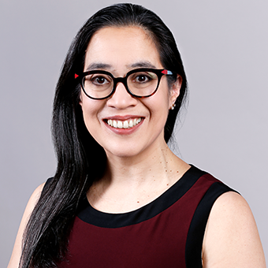
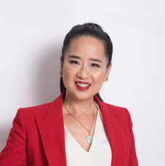

MEET THE DHC LAWYERS
Fay Faraday
Lai-King Hum
Natasha Persaud

Slide 5
ROLE OF THE DHC: PURPOSE
DHC program
helps ensure licensees of the LSO (Lawyers and Paralegals) and licensee candidates comply with their professional obligations.
Licensees’ obligations with respect to discrimination and harassment are set out in their respective Paralegal Rules of Conduct (Rules 2.03 & 2.04) and the Lawyers’ Rules of Professional Conduct (Rules 6.3.1 & 6.3-3).
helps individuals who have experienced discrimination or harassment by an LSO licensee or licensee candidate.

Slide 6
ROLE OF THE DHC: SERVICES
How can the DHC help?
The DHC is a confidential service funded by the Law Society of Ontario (LSO).
Provides guidance and information about options available to those who have experienced discrimination or harassment specifically by lawyers or paralegals.
Mediation and conciliation services in some circumstances.
Other services include coaching and outreach.
The DHC does not provide legal representation, legal advice, or investigation services.
The DHC provides anonymized statistical information to the LSO and the public.
FREE
INDEPENDENT
CONFIDENTIAL

Slide 7
The DHC helps those who have experienced or witnessed discrimination and/or harassment contrary to the Human Rights Code where the negative conduct is
by a licensee of the LSO, or
by students who are in the process of obtaining their licence with LSO
Purpose
Free
Confidential
Independent
Statistical Information
To support the LSO with licensee obligations respecting compliance with LSO’s Rules of Conduct
Free Service to anyone discriminated or harassed by a licensee or licensee candidate
The DHC provides completely confidential services
The DHC is funded by the LSO, while remaining independent and working at arm's length from LSO – BY-LAW 11
Provides anonymized statistical information to LSO and to the public
Help Explore Options Available
Mediation and Conciliation Services
DHC does not provide legal advice or representation or investigate complaints

Slide 8

THANK YOU!
FAY FARADAY
Lai-King Hum
Natasha Persaud
Saba Quadri
Toll Free: 1-877-790-2200
Email: assistance@dhcounsel.on.ca
Visit: https://lso.ca/dhc/home
Scan to learn more

