Slide 1
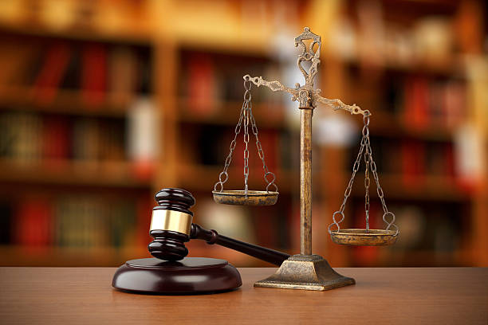
Witness Evidence
Grazia Condello, LL.B., LL.M.
Neuberger & Partners LLP
grace@nrlawyers.com

Slide 2
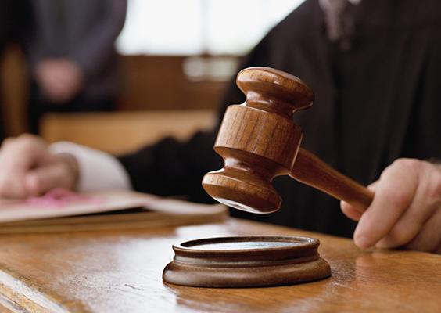
The Law of Evidence
“Few cases ultimately turn on disagreements about the law. Most cases come down to disputes about facts.”
Justice David Paciocco, The Law of Evidence
Relevant evidence is evidence that contributes to proving or disproving a fact in dispute
The law of evidence is about facts and facts are infinitely variable

Slide 3
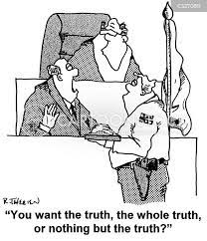
Witness Evidence
The trier of fact relies on the observations of a witness in deciding whether to accept a statement of fact as true

Slide 4
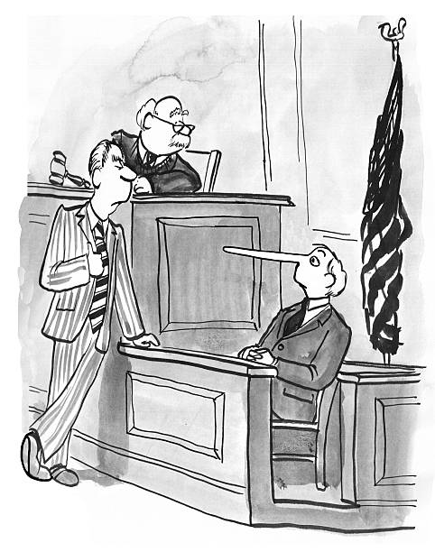
Considering witness testimony: 4 general factors
Perception
declarant may have misperceived the facts to which the hearsay statement relates
What did the witness actually see? Was it dark? Were there obstructions to their view?
Memory
Even if remembered correctly, perceived facts may have been wrongly remembered
Witness Narration
events narrated facts in an misleading manner
did witness take out of context, ie. witness said they observed a punch vs. hit
Sincerity
declarant may have knowingly made a false assertion

Slide 5
Assessing the credibility and reliability of witnesses
Reliability:
it is important to distinguish where a witnesses has a motive to fabricate or bias
or where they may be sincere and honest, but completely wrong about what they observed - these can be the most problematic types of witnesses because they are genuine in their statements and testimony about what they observed
According to Innocence Canada:
Eyewitness identification error is one of the primary contributors to wrongful convictions. According to the Innocence Project, it was a contributing cause in approximately 70% of convictions overturned through DNA testing.

Slide 6
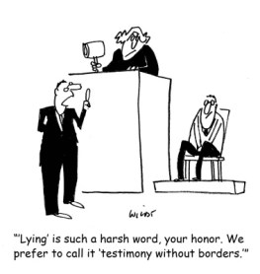
Witness Evidence & hearsay
the general rule is: witness statements not made under oath, cannot be tendered for the “truth of it’s contents” or substantive evidence, unless:
the witness adopts their statement, or it falls within the exception to the hearsay rule
- R v. Khan, [1990] and R v. Smith, [1992]
The difficulty for the trier of fact is where there are two different or competing versions between witnesses - this is when credibility of witness comes into play

Slide 7
What is hearsay ?
Hearsay is an out-of-court statement that is being admitted for the truth of its contents
Out of court:
Encompasses statements given by a witness who is not before the court and
Also encompasses prior out-of-court statements made by the very witness who is testifying in court when their earlier statement is tendered for its truth
Statement :
Written or oral statements
Can be communicative conduct /non-verbal acts – something intended to convey without words (eg. nodding of the head, pointing, etc.)

Slide 8
Witness Evidence & hearsay
To understand hearsay, need to understand the dangers that give rise to the exclusionary rule
The fundamental concern lies in the inherent difficulty of testing the accuracy of the factual claims of the out of court statement
Our adversary system requires witness being called to give evidence under oath, whose demeanour can be observed and subjected to cross examination by opposing counsel

Slide 9
How to apply the hearsay rule?
1. Who is the declarant? → ie. person out of the court
2. What does the statement assert? → what is the content?
3. What is the purpose of tendering the assertion? → why does the party want this evidence in?

Slide 10
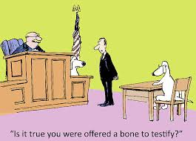
Is the witness lying…..
It is difficult for a trier of fact to assess conflicting evidence of a witness
Generally, it is not common to have direct evidence of a witness’ unreliability or lie about their testimony
A trier of fact may find that a witness has exaggerated, misstated, or lied based upon various factors …

Slide 11
Assessing the credibility and reliability of witnesses
Internal inconsistencies:
where a witness has given a prior statement – and while giving evidence, either in a new statement or viva voce testimony, and stating something inconsistent with what they said before
External inconsistencies:
asses whether the witness is inconsistent with another witness’ statement or testimony
Unreliability or Motive to Fabricate :
Unreliability: ie. mistaken due to lighting or distance
Motive to fabricate:
is witness at arms length from the parties to the proceedings (ie. family or friend)
is there any hostility or self-interest to fabricate

Slide 12
Is the witness lying…
Relying on assumptions about how people normally behave to make findings of fact or credibility engages “speculative reasoning”
While judges may use their common sense about human behaviour, reasonsing should be rooted in the evidence and not based upon stereotypical inferences, R v R.C., 2021 ONCA 582
“rule against ungrounded common-sense assumption”
judges should avoid speculative reasoning that invokes common sense assumptions that are not grounded in the evidence; and
“rule against stereotypical inferences”
it is an error to rely on stereotypes or erroneous common sense assumptions about how a sexual assault complainant is expected to act, it is equally wrong to draw inferences about how an accused person is expected to act
R v J.C., 2021 ONCA 131

Slide 13
Demeanour evidence
The demeanour or manner of how the witness responds to questions
Whether the witness is evasive
Argumentative
Angry
Hesitant to answer
Laughing at your question (put it on the record “Why are you laughing..)
Not answering by answering with their own narrative

Slide 14
Demeanour evidence
Improper use of a defendant’s demeanour: R. v. Hemsworth, 2016 ONCA 85
TJ found defendant testified in a manner that was too “careful” – CA said the D could have been just nervous
judge will evaluate credibility of witness by observing the manner in which they give responses - a slow response could indicate a witness is either fabricating their answer or they have anxiety in high stress situations such as a courtroom.
Ie. failure to make eye contact could be indication of lying, or it could be a shy temperament or cultural upbringing.
demeanour evidence can be “highly instructive”, ie. witness who moves from expressing themselves calmly, to a dramatic change of “downright hatred at counsel by a witness who obviously senses he is getting trapped.”

Slide 15
Character Evidence
Its probative value depends on the proposition :
The fact that a person has a tendency to act a particular way does not mean that they will always act that way
generalizations in character typing tend to be pejorative and judgmental, and presents a risk of prejudice.
Character and mere habit :
A habit → is a regular tendency of a person to engage repeatedly in a particular kind of conduct, can be evidence of how a person likely acted on the occasion in question with out reflecting on character

Slide 16
Character Evidence
moral prejudice:
Where D will be judged based on their character or stereotype about human conduct rather than on the evidence which is a forbidden chain of reasoning of general disposition or propensity
Reasoning prejudice:
Distracts the trier of fact from its proper focus on the charge itself
Statements of opinion → ie. John is a dishonest person or good person
Reputation → ie. John has good reputation in community
Character → ie. John is a psychopath
Evidence of good character of a witness for the purposing of bolstering credibility of the witness is not admissible.

Slide 17
Bad Character Evidence
Information about an individual that a reasonable person is likely to find to be morally objectionable or has a contemptible or reprehensible character
Probative value vs. Prejudicial effect
Is character evidence probative?
ie. May use bankruptcy can be used to establish that a person is bad with their money, or motive for fraud
Is character evidence prejudicial?
Illogical use (moral prejudice)
Too much weight (reasoning prejudice)
Confuse/mislead (reasoning prejudice)

Slide 18
Character of the Accused: general exclusionary rule
Crown cannot adduce evidence of the accused’s “general” bad character either in the form of specific acts or reputation as circumstantial proof that the D has the propensity or disposition to do the type of acts charges and therefore guilty of the offence
R v Johnson 2010 ONCA
Crown cannot lead “extrinsic evidence” about the D’s behaviour on other occasions or their general character simply to show that the D is the sort of person likely to commit the offence charged - to infer guilt from the mere character of the accused is a “forbidden type of reasoning”

Slide 19
Exception to the Bad Character rule
The Rule:
The accused puts their character in issue by leading evidence of good character.
Where the accused puts their character in issue, the Crown is entitled to refute the good character evidence with evidence of bad character.
the responding evidence should be proportionate and not overly prejudicial – there are limits
Important to prepare your client to testify!

Slide 20
Prior Inconsistent Statement – Impeaching the witness
Prior inconsistent statements by a non-party witness may be admitted when a witness recants their earlier out of court statement
Canada Evidence Act, s. 10 (written statement), s. 11 (oral statement)
How to impeach:
Counsel has the witness confirm present testimony and make the witness’ testimony on the issue they intend to contradict the witness on as clear as possible.
Counsel then confronts the witness with the making of a prior statement.
Counsel then puts the contradiction in the prior statement to the witness.
Counsel may then ask the witness to adopt the prior statement.

Slide 21
Prior Consistent Statements
Definition of ‘prior consistent statement’ = statement made by a witness out of court that is consistent with the testimony they give while on the stand.
Prior consistent statements are generally inadmissible
Why? Irrelevant, Self-serving, Hearsay
Exception to the rule:
1. to rebut an allegation of recent fabrication
2. Prior consistent statements are admissible as part of the narrative to show how the story unfolded

