Slide 1

The ins and outs of debt recovery:
A practical approach
By: Byron Lott and Christina Bradley of Rubenstein, Siegel, Barristers and Solicitors

Slide 2
The “Collectability” Assessment
Is the debtor worth suing?
Does the debtor own property or other assets?
  Equity in the asset?
  Other debts?
Does the debtor earn income that would be subject to enforcement?
Do we know where the debtor is?
  Any potential issues in serving the Claim
Limitation issue?
Insolvency

Slide 3
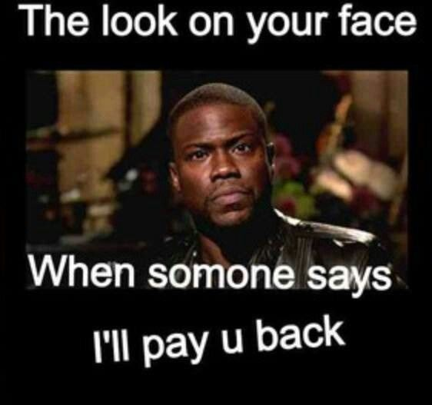
Have you asked them to pay?

Slide 4
Judgments
A judgment is a right to collect, not the money itself. This phase is the heart of debt recovery.
Judgment do not expire, but leave is required to enforce the Judgment after 6 years.

Slide 5
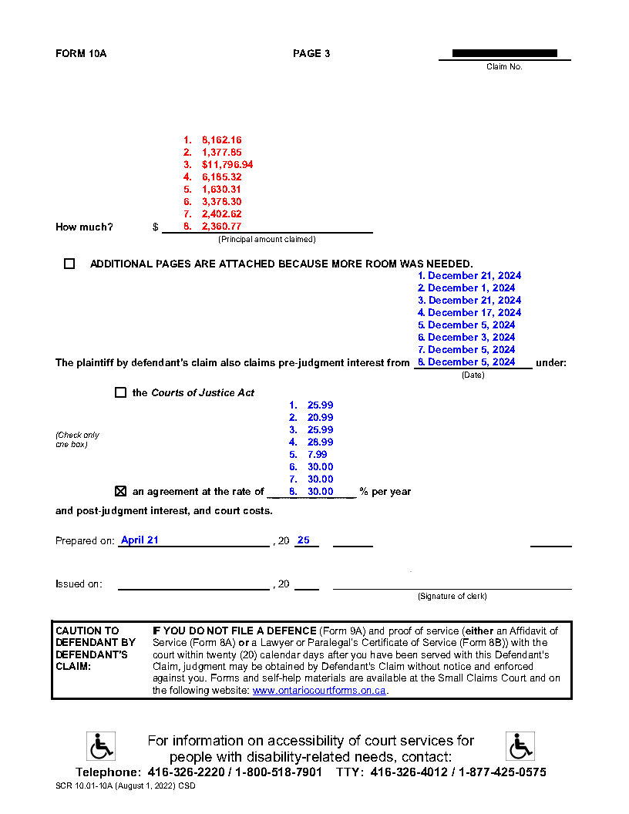
Pleadings
Avoiding common pitfalls
Goal is to have the clerk of the court sign judgment.
Clear and concise language
Attach supporting documents (e.g., invoices, contracts) to the Plaintiff’s Claim where possible to reduce chances of court clerk rejecting a default judgment.
Sue multiple accounts in one claim

Slide 6
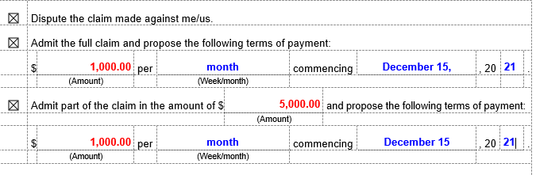
Defended Action
Rule 9 of the Rules of the Small Claims Court – Defence and Admission of Liability and Proposal of Terms of Payment
Rule 13 of the Rules of the Small Claims Court – Settlement Conference

Slide 7
Settlement Conference
Know the Rules and Set the Stage
Mandatory unless the defendant admits the FULL claim or the parties file terms of settlement.
This is also the “discovery process.”
Main goal is to settle
Set the stage for your next step
Determine your next steps
  Rule 12 Motion
  Trial

Slide 8
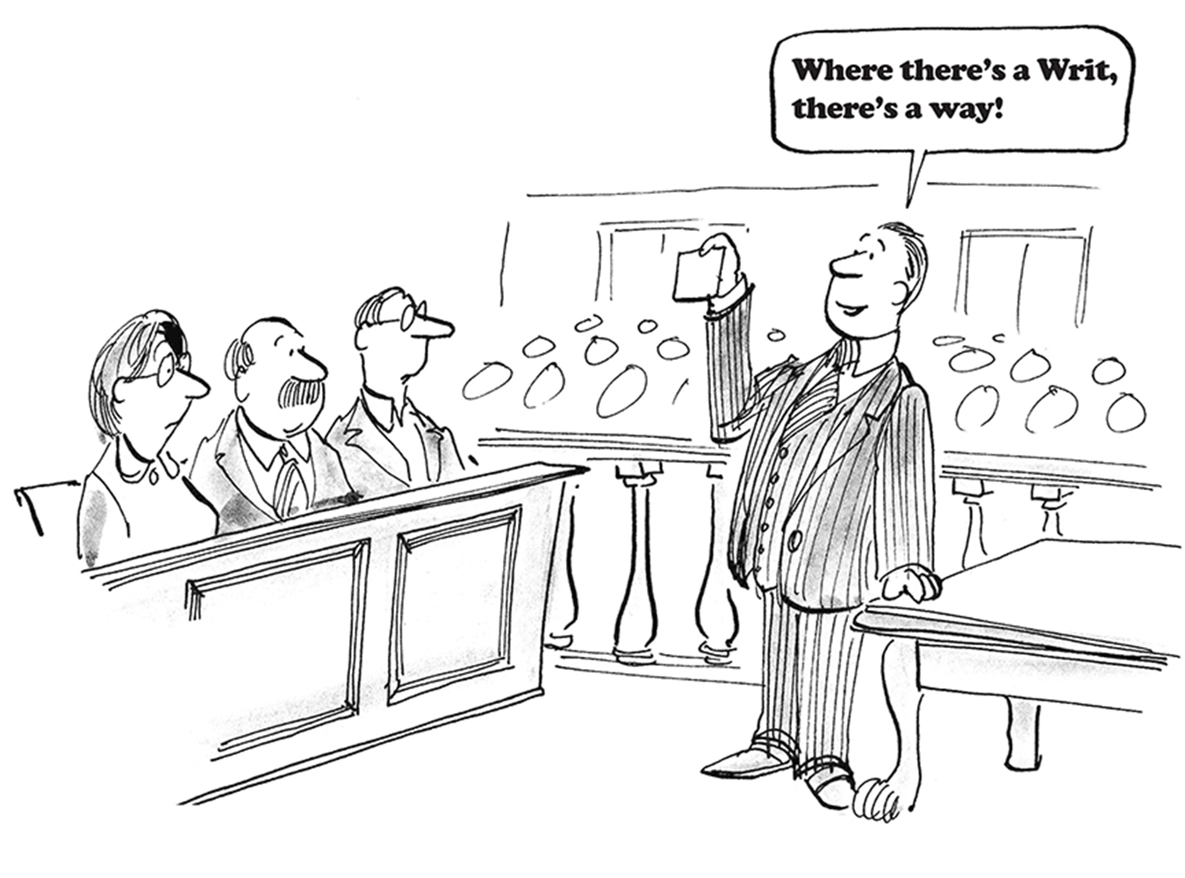

Slide 9
Writs
Writ of Seizure and Sale of Land
Issue by the Court and Filed with the Sheriff
A Writ encumbers any land presently owned or land that may be purchased in the future by the debtor in the jurisdiction where the writ is filed.
Enforcement Considerations
  Is the Debtor the sole owner of the property?
  Name on title?
  Is there still equity?
  Does the debtor still own?

Slide 10
Garnishments
The most common and effective tool. It allows you to intercept money owed to the debtor by a third party (Garnishee), such as an employer (wage garnishment) or a bank (bank account garnishment).
What can you garnish?

Slide 11
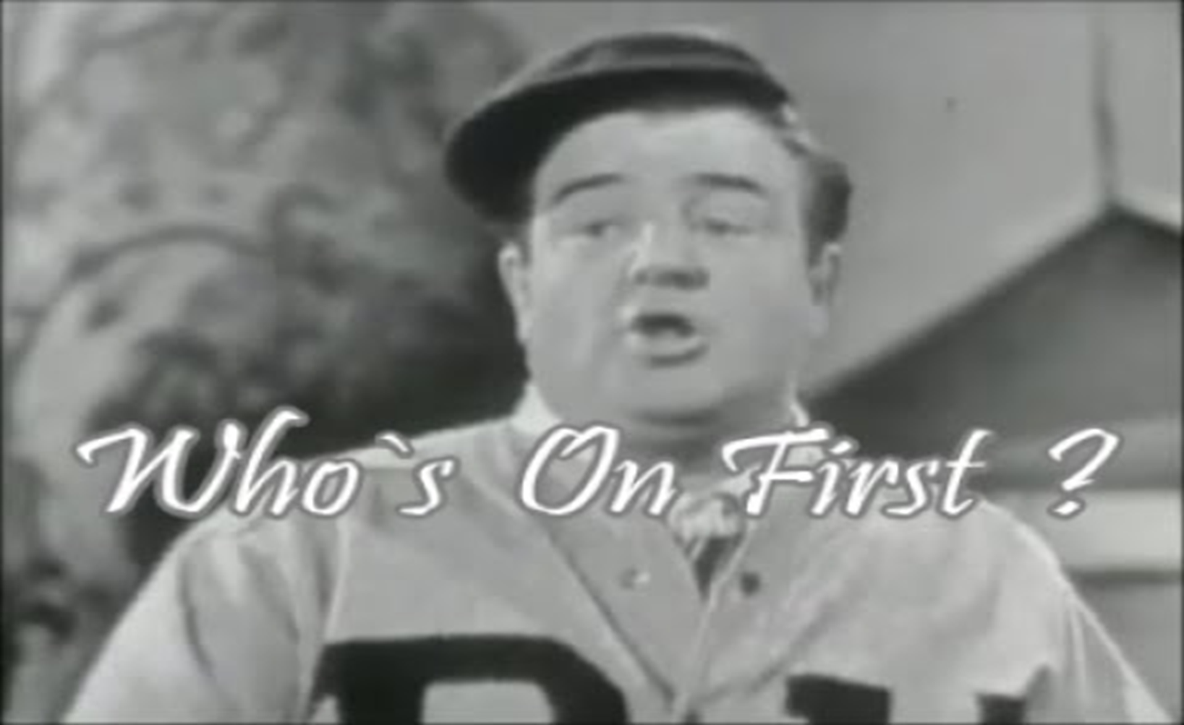

Slide 12
PRIORITY AMONG CREDITORS
CRA
Support or Maintenance Orders (FRO);
The Crown in Right of Canada (Federal);
The Crown in Right of Ontario (Provincial);
All other creditors.
SCC – if there are no creditors with priority, funds are distributed equally among creditors.
Superior Court – if there are no creditors with priority, funds are distributed proportionately among creditors.

Slide 13
SHERIFF
*Once CRA/FRO has been paid, money received will be split proportionately among creditors
*CRA has priority and will be paid first
CRA
writ
($50,000.00)
BANK
Garnishment
($110,000.00)
BYRON LOTT
writ
($30,000.00)
CREDIT UNION
writ
($29,000.00)
if another creditor has a writ filed in the same jurisdiction against the same debtor and is actively enforcing it, you will share, on a pro-rata basis, in any money paid into the Sheriff from any enforcement activity taken against the debtor.
*If the sheriff is sending funds to CRA because they have priority over other creditors and then the FRO files a writ/garnishment, FRO would then take priority over the CRA.
FAMILY RESPONSIBILITY OFFICE
writ
($5,000.00)

Slide 14
SCC CLERK
CRA
# 2Garnishment
($20,000.00)
BANK
#3 Garnishment
($15,000.00)
BYRON LOTT
#3 Garnishment
($8,000.00)
CREDIT UNION
#3 Garnishment
($17,000.00)
*The Court Clerk will pay garnishment creditors with priority first. Once creditors with priority have been paid, the Clerk will distribute the funds equally among creditors with a garnishment in place which has not been paid in full.
FRO
#1 Garnishment
($5,000.00)

Slide 15
Examination in Aid of an Execution a.k.a. Judgment Debtor Examination Hearings
Examination Hearing: If you lack information about the debtor’s assets, employment, or bank accounts.
Examinations are conducted in private and are under oath
Set the Stage
  What to prepare with a notice of examination
  Duties of the person being examined
  Order to set out clear consequences
Test for a Contempt Order

